Slide 1
Discrete Structures
INSTRUCTOR: ANAM ASHRAF

Slide 2
Recap
Logic
Statement
Proposition
Compound Proposition
Logical operators
  Negation, Conjunction, Disjunction, Implication, Biconditional, Exclusive OR
Converse Contrapositive and inverse

Slide 3
Overview
Tautology (valid argument)
Contradiction
Contigency (Invalid argument)
Logical Equivalences
Satisfiable

Slide 4
Equivalent Statements
P | Q | ¬(P∧Q) | (¬P)∨(¬Q) | ¬(P∧Q)↔(¬P)∨(¬Q)
true | true | false | false | true
true | false | true | true | true
false | true | true | true | true
false | false | true | true | true
The statements ¬(P∧Q) and (¬P)∨(¬Q) are logically equivalent, because ¬(P∧Q)↔(¬P)∨(¬Q) is always true.

Slide 5
Example 3
Prove that p → q and ¬ p ∨ q are equivalent
Proof using Truth tables
P | Q | P->q | ¬P | ¬PVQ
T | T | T | F | T
T | F | F | F | F
F | T | T | T | T
F | F | T | T | T

Slide 6
Tautology
A compound proposition that is always TRUE, e.g. q ∨ ¬q
Logical equivalence redefined: p,q are logical equivalences if p ↔ q is a tautology. Symbolically p ≡ q.
Intuition: p ↔ q is true precisely when p,q have the same truth values.

Slide 7
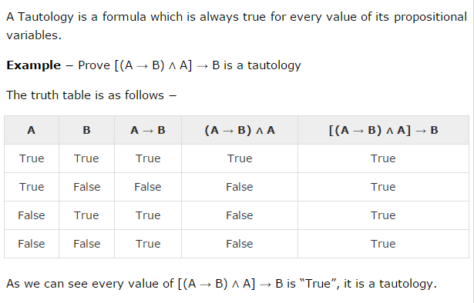
Tautology Example

Slide 8
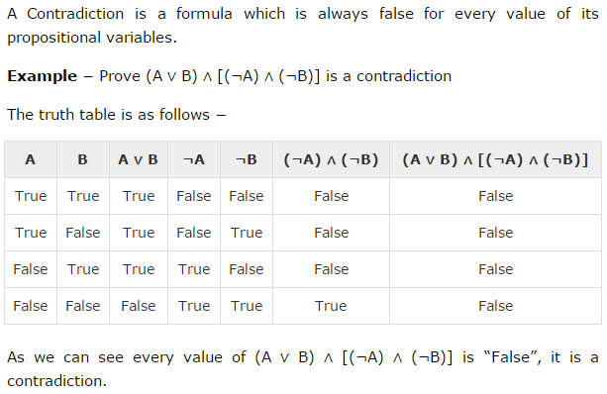
Contradiction
A compound proposition that is always FALSE e.g. q ∨ ¬q

Slide 9
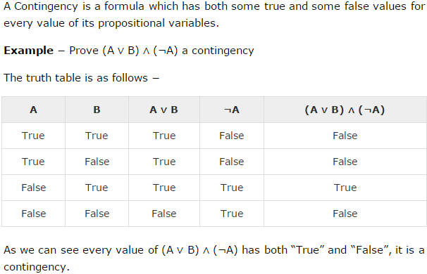
Contingency
Contingency is a compound statement that is neither a TAUTOLOGY nor a CONTRADICTION

Slide 10
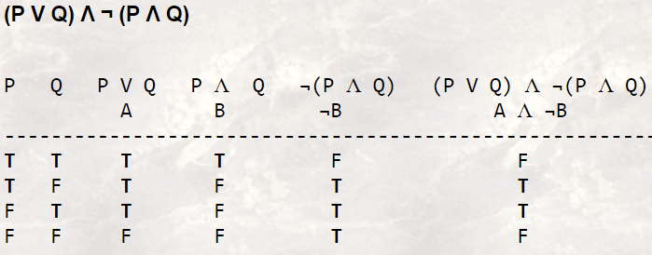
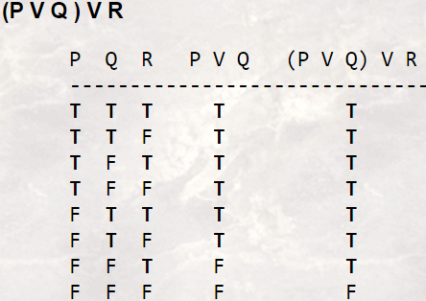
Examples

Slide 11
Distributive Laws
p ∧ (q ∨ r) ≡ (p ∧ q) ∨ (p ∧ r)
p ∨ (q ∧ r) ≡ (p ∨ q) ∧ (p ∨ r)
Proof: use truth tables.

Slide 12
De Morgan’s Laws
¬( p ∨ q) ≡ ¬p ∧ ¬q
¬(p ∧ q) ≡ ¬p ∨ ¬q
Proof: use truth tables.

Slide 13
TABLE 6 Logical Equivalences
Equivalence | Name
p ∧T≡p p∨F≡p | Identity Laws
P ∨ T ≡T p∧F≡F | Domination Laws
p∨p≡p p∧p≡p | Idempotent Laws
¬ ( ¬ p)≡p | Double Negation Law
p ∨ q ≡ q ∨p p ∧ q ≡ q ∧p | Commutative Laws
Notes:
Equal sign show that they are logically equalient

Slide 14
TABLE 6 Logical Equivalences CONTD
Equivalence | Name
(p ∨ q) ∨ r ≡ p ∨ (q ∨r) (p ∧ q) ∧ r ≡ p ∧ (q ∧r) | Associative Laws
p ∨ ( q ∧ r) ≡ ( p ∨ q)∧ (p ∨ r) P ∧ (q ∨ r) ≡ (p ∧ q) ∨ (p∧r ) | Distributive laws
¬(p∧q)≡¬p∨¬q ¬ (p ∨ q) ≡¬ p∧¬q | De Morgan’s laws
p ∨ (p ∧ q)≡p p ∧ (p ∨ q)≡p | Absorption law
p ∨¬p ≡T p∧¬p ≡F | Negation laws

Slide 15
TABLE 7 Logical Equivalences Involving Conditional Statements.
p → q ≡¬ p ∨ q p → q ≡¬ q →¬p p ∨ q ≡¬ p →q p ∧ q ≡¬ (p →¬q) ¬ (p → q) ≡ p∧¬q (p → q) ∧ (p → r) ≡ p → (q ∧ r) (p → r) ∧ (q → r) ≡ (p ∨ q)→r (p → q) ∨ (p → r) ≡ p → (q ∨r) (p → r) ∨ (q → r) ≡ (p ∧ q)→r

Slide 16
TABLE 8 Logical Equivalences Involving Biconditional Statements.
p ↔ q ≡ (p → q) ∧ (q →p) p ↔ q ≡¬ p ↔¬q p ↔ q ≡ (p ∧ q) ∨ ( ¬ p∧¬q) ¬ (p ↔ q) ≡ p ↔¬q

Slide 17
EXAMPLE 6
Show that ¬(p →q) and p∧¬q are logically equivalent
¬ (p → q) ≡¬ ( ¬ p∨q) by Example 3
≡¬ ( ¬ p)∧¬q by De Morgan law
≡ p∧¬q by the double negation law
Hence ¬(p →q) and p∧¬q are logically equivalent

Slide 18
Example 7
Show that ¬ (p ∨ ( ¬ p∧q)) and ¬ p∧¬q are logically equivalent by developing a series of logical equivalences.
¬(p∨(¬p∧q))≡¬p∧¬(¬p∧q) by De Morgan law
≡¬ p ∧[¬ ( ¬ p) ∨¬q] by De Morgan law
≡¬ p ∧ (p∨¬q) by the double negation law
≡ ( ¬ p ∧ p) ∨ ( ¬ p∧¬q) by distributive law
≡ F ∨ ( ¬ p∧¬q) because ¬p∧p ≡F
≡ ( ¬ p ∧¬q)∨F by commutative law
≡¬ p∧¬q by the identity law for F
Consequently ¬(p∨(¬p∧q)) and¬p∧¬q are logically equivalent

Slide 19
EXAMPLE 8
Show that (p ∧ q) → (p∨q) is a tautology
(p ∧ q) → (p ∨ q) ≡¬ (p ∧ q) ∨ (p∨q) by Example 3
≡(¬p∨¬q)∨(p∨q) by De Morgan law
≡ ( ¬ p ∨ p) ∨ ( ¬ q ∨q)
by the associative and commutative laws for disjunction
≡T∨T
by Example 1 and the commutativelaw for disjunctio ≡T by the domination law
Notes:
(p → q) ≡( ¬ p∨q)

Slide 20
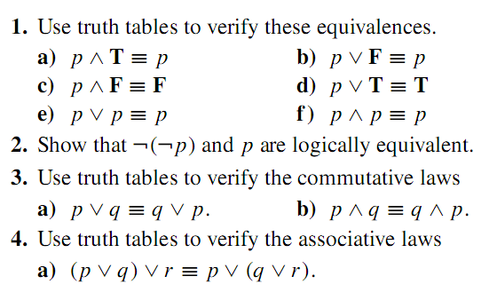
Home task

Slide 21
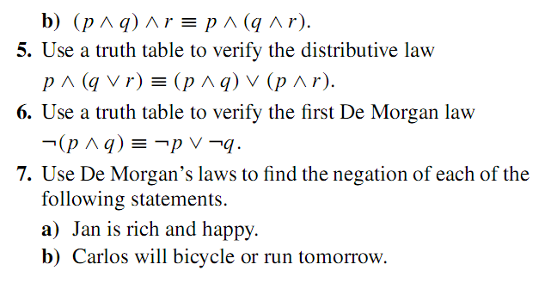
Home task

